Slide 1
Enterprise TFS Training
Operations Training - Session 1
Mike O’Brien
September 2014

Slide 2
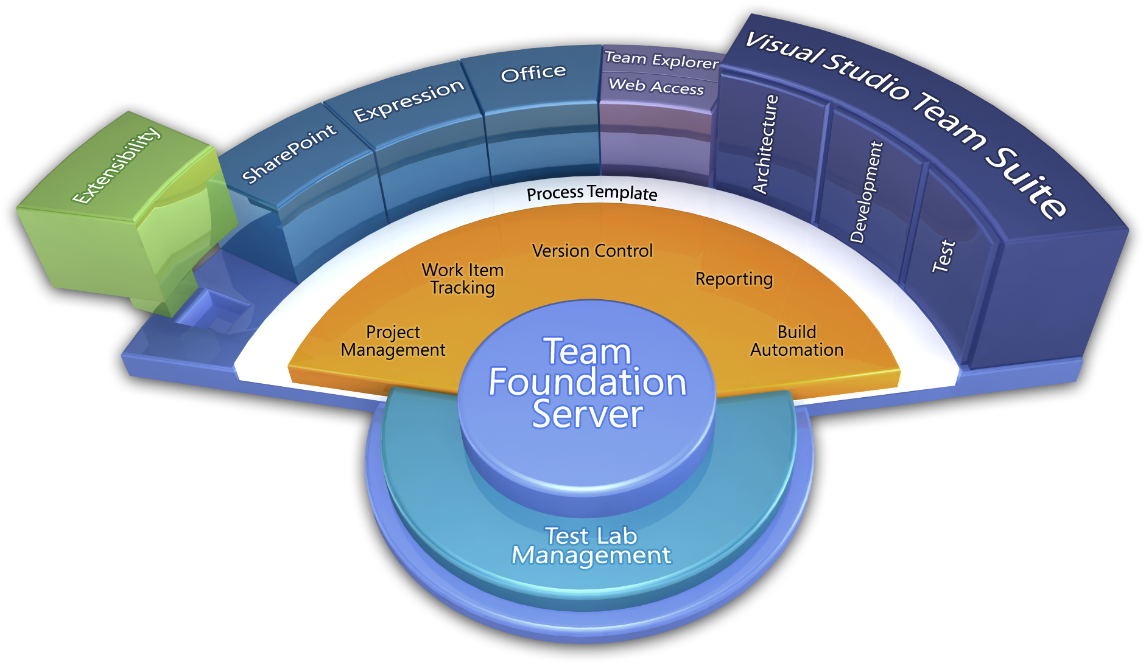
What is Team Foundation Server (TFS)?
Team Foundation Server is a Microsoft product which provides source code management, reporting, requirements management, project management, automated builds, lab management, testing and release management capabilities.
Process / Optimization
Project Management
Requirements Management
Design & Architecture
Release Management
Development
QA & Test
Application Lifecycle Management (ALM)
Application Lifecycle Management using Visual Studio Team Foundation Server provides proven practices to manage application lifecycle. Manage source code across teams; develop, build, and test applications; plan projects, track work, and report progress.

Slide 3
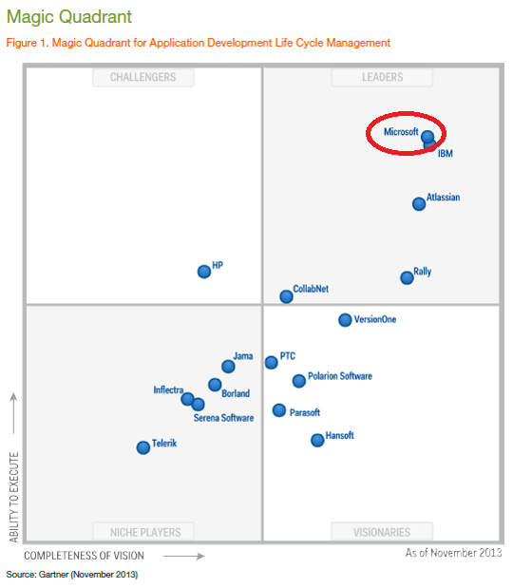






Why TFS?
Notes:
Magic Quadrant from TFS 2012
Large companies = US Bank, Target, Boeing, Dell, HP
TFS - market leader
In use widespread use within 3M
SEMS active user since 2006 – initial version of TFS
In use by other large companies for Enterprise wide use

Slide 4
Current ALM Landscape at 3M
Current Situation
TFS in wide use across 3M – up to 30 servers
Each with staff to maintain, backup and upgrade
Annual cost per server = $42k
30 servers = $1.2M
And more systems coming online every day!
Decentralized Services within 3M
Small scale development systems
Lack of common infrastructure
Little or no reuse of solutions across groups/divisions/company
Redundancy of personnel
Underutilization of technology
TFS
Rational
Notes:
Divisions with resources needed to support infrastructure
As Divisions move to ETFS, resources are freed up to develop

Slide 5
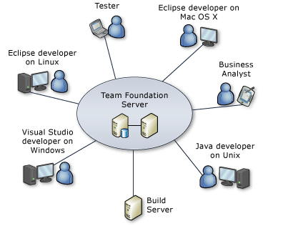
Who would use ETFS?
Project Management – plan, schedule, assign and track a project
Business Analyst – record and track requirements
Tester – track bugs – what’s fixed, what to test
Software development teams – Windows / Android / iOS / embedded systems
DevOps – automated build, test and deploy
Stakeholders – see progress of project
Regulatory – track requirements and outstanding issues
Product teams (e.g., XBox) have successfully used TFS for hardware/software delivery.
Globally available

Slide 6
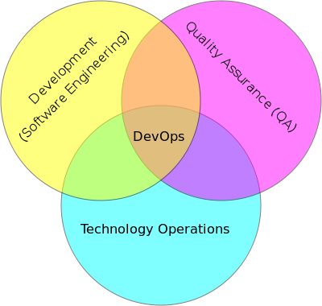
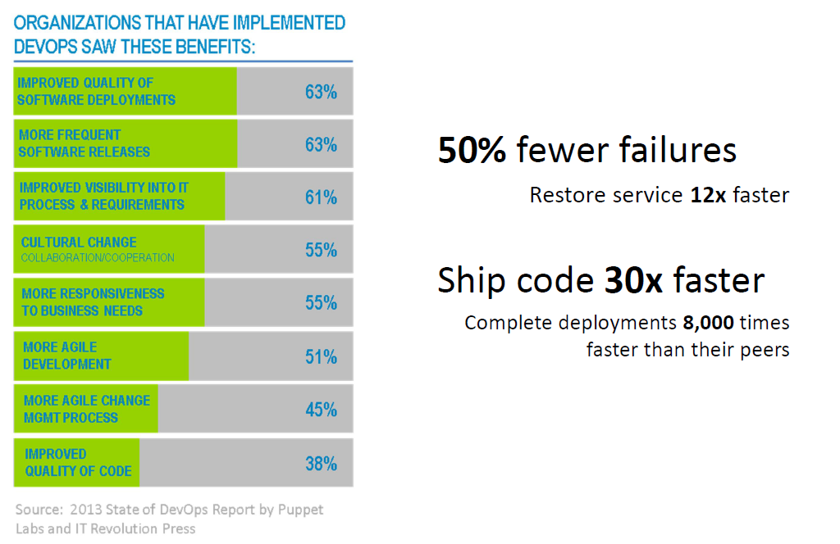
SEMS DevOps
DevOps Role
Automate Build, Deployment, Configuration, Testing and production deployment
SEMS DevOps Role
ETFS - Team Onboarding and Migration
ETFS - Service Enhancements
Perform DevOps Role for SEMS and Division Teams (T&M)
Notes:
“Automate Everything”

Slide 7
ETFS Team Roadmap
Build - 2014 Q4
1 Service Manager
2 DevOps (+1 new contractor)
1 Ops (IT)
Service Manager
- Initial contact of new teams
- Provide training
- Maintain relationship with teams
- Oversight of DevOps and Ops Teams
Operations (Ops)
- IT Operations Team
SEMS DevOps
- Team onboarding tasks
- Service enhancements
- Test updates/upgrades, update documentation
- Perform DevOps role for SEMS/Division teams
- ETFS System Maintenance
- Respond to support requests
- Focused on Production System
Adopt - 2015
1 Service Manager
3 DevOps (+1 new contractor)
1 Ops (IT)
Mature - 2016
1 Service Manager
4 DevOps (+1 new hire)
1 Ops (IT)

Slide 8
ETFS 2014 Timeline
HIS Target for all TFS teams migrated
Startup Investment
Service Available
All HIS teams migrated
Pre-NTI
May 5
Sept
Jan
March
March
2014
May
Jun
July
Aug
Sep
Oct
Nov
Dec
Jan
Feb
Mar
Apr
May
Jun
Define
Implementation
Ongoing
Today

Slide 9
Technology Platform and Roadmap
Requirements
Authoring Requirements document with Enterprise defined structure, methodology, and process
Cloud Hybridization
Cross Platform Builds
(iOS / Xamarian / Android / Linux)
Rollup Reporting
(self-service reporting portal)
Value Added
DevOps
Automated build, deploy and testing harnesses
Enterprise Software Development Process
Process Template
Project Management
Requirements Management
Version Control
Test Case Management
Build Automation
Reporting
TFS Technology
Platform
TFS

Slide 10
Task Timeline
Service Available
Jan
Aug | Sep | Oct | Nov | Dec | Jan | Feb | Mar | Apr | May | Jun | July
Cost
Migration Tool Investigation
Install QA/PROD
IT Ops Team Training
Build Team Onboarding Queue
Onboard HIS Teams
Onboard SEMSTFS teams

Slide 11
ETFS Architecture for QA and PROD

Slide 12
ETFS - Environments
Trial & Demo - multiple environments
Single use TFS servers for demos & trial use
DEV - tfsdev.mmm.com
Dual server Application Tier
Shared Database instance in IT Databse infrastructure
QA - tfsqa.mmm.com
Dual Server Application Tier in Datacenter
Mirrors Prod in functionality
Hosted in SEMS infrastructure - not backed up, no redundancy
Shared SSAS and SSRS
PROD - tfs.mmm.com
Dual Server Application Front Ends
Hosted in 3M Datacenter
Monitored by SCOM
Backed up by IT backup systems
Database on dedicated database cluster setup and maintained by IT Database team
Database on dedicated database cluster setup and maintained by IT Database team
Prototype new functionality
http://tfsarchive.usac.mmm.com:8080/tfs
http://tfsdev.mmm.com:8080/tfs
http://tfsdev.mmm.com
http://devsql46/reports
http://tfsqa.mmm.com:8080/tfs
http://tfsqa.mmm.com
http://tfsqa.mmm.com/reports
http://tfs.mmm.com:8080/tfs
http://tfs.mmm.com
http://tfs.mmm.com/reports

Slide 13
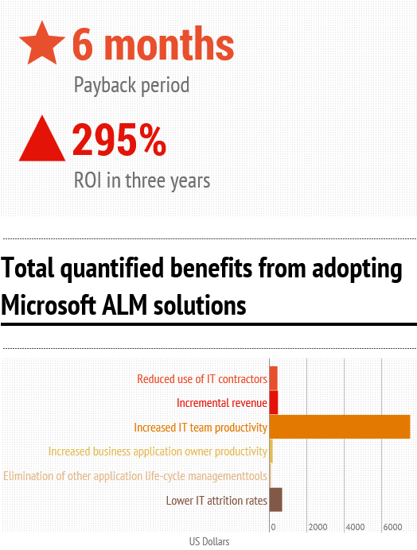
Benefits of Enterprise TFS Solution
Centralized Repository
High Availability
Improved Disaster Recovery
Increased collaboration/sharing
Reduced cost
Support Specialists – customization, maintenance and support
Visibility – customized Key Performance Indicators (KPI’s)
Training – increased knowledge of capabilities
Infography created by InCycle Software
Source information from Forrester: The Total, Economic Impact of Microsoft Application Life Cycle Mangement
Notes:
Dell case study – ROI: 225% Payback: 6 months
CollabNet case study: ROI 225% Payback: 12 months
Key benefits from case studies?

Slide 14
Thank You!

